Slide 1
INTEREST RATE DERIVATIVES (IRD)
Name: Harikrishna
Title: Interest Rate Derivatives(IRD)
Company Name:Vishist Business Solutions Pvt Ltd

Slide 2
Overview
Introduction(IRD)
Abstract
Scope
Existing System.
Proposed System.
Products
Over the Counter(OTC)
Exchange Trade (ET)
System Architecture.
Data Flow Diagram.
Screen Shots.
Swap Pricing Screens
Swaption Pricing Screen
Caps/Floor Pricing Screen
Fras Pricing Screen

Slide 3
Swap
Swaption
Caps/Floor
Fras
Exchange Trade Products
Money Market Future
Bond Futures
Bond Future Option
Bond Option Conclusion. Future Enhancements. Reference/Appendices.

Slide 4
1.Introduction
An interest rate derivative is a derivative where the underlying asset is the right to pay or receive a notional amount of money at a given interest rate. In financial terms, a derivative is a financial instrument - or more simply, an agreement between two people or two parties - that has a value determined by the price of something else (called the underlying). It is a financial contract with a value linked to the expected future price movements of the asset it is linked to - such as a share or a currency.
There are many kinds of derivatives, with the most notable being swaps, futures, and options. However, since a derivative can be placed on any sort of security, the scope of all derivatives possible is near endless. Thus, the real definition of a derivative is an agreement between two parties that is contingent on a future outcome of the underlying.

Slide 5
2.PRODUCTS
Over The Counter
Swaps
Swap Option
Caps/Floors
Forward Rate Agreement
Exchange Trade
Money Market Futures
Money Market Future Options
Bond
Bond Future
Bond Future Option

Slide 6
Swaps
A swap is a cash-settled OTC derivative. Except for forwards, swaps are the simplest form of OTC derivative.
A swap is an agreement between two counterparties to exchange two streams of cash flows—the parties "swap" the cash flow streams. Those cash flow streams can be defined in almost any manner. All that matters is that their present values be equal (except for a bid-ask spread, if one party to the swap is a dealer). While swaps are used for various purposes—from hedging to speculation—their fundamental purpose is to change the character of an asset or liability without liquidating that asset or liability.
For example, an investor realizing returns from an equity investment can swap those returns into less risky fixed income cash flows—without having to liquidate the equities. A corporation with floating rate debt can swap that debt into a fixed rate obligation—without having to retire and reissue debt.

Slide 7
Following are the swaps supported by IRD
Vanilla Swap
Cross Currency Swap
Asset Swap
Fx Reset Swap
Amortizing Swap
Compounding Swap
Overnight Index Swap
Constant Maturity Rate Swap(CMS)
Quanto swap
Basis Swap

Slide 8
Vanilla Swap:-
A Vanilla Swap is any swap with fairly standardized provisions. The term is usually applied to vanilla interest rate swaps or vanilla currency swaps. Vanilla swaps are appealing because pricing tends to be transparent and transaction costs are small. Vanilla swaps can be used to speculate or to quickly hedge the market risk of a position without necessarily offsetting the specific cash flows of that position.
Vanilla swaps have two legs – pay leg and receive leg. In which one leg is based on fixed rate of interest while other one based on floating rate of interest.
Swaps can also be customized to offset the specific cash flows of a position. Dealers often structure such non-vanilla swaps for clients. They may charge a fee for doing so, and pricing may reflect a large bid-ask spread (caveat emptor).

Slide 9
Cross Currency Swap:-
Cross Currency Swap (CC Swap) is an instrument that may be used to swap the interest-rate and currency risk on a loan. A CC Swap is often used in conjunction with the issue of a debenture loan. Using a CC Swap may reduce the funding charges.
Cross Currency Swaps are suitable for companies that wish to control the interest-rate risks in foreign currencies stemming from their standard business operations.
Asset Swap:-
Asset swap is a non-vanilla swap customized to change the character of a specific asset. It is an exchange of tangible assets for intangible assets or vice versa. Since it is a swap of assets, the procedure takes place on the active side of the balance sheet and has no impact on the latter in regards to volume. As an example, a company may sell equity and receive the value in cash thus increasing liquidity.
A company often utilizes this method when in need for money to invest (internal financing) or to pay-off debts. Such swaps usually have stub periods in order to bring the chronology of the cash flows into line with that of the underlying bond.

Slide 10
Amortizing Swap:- Amortizing swap is usually an interest rate swap in which the notional principal for the interest payments declines during the life of the swap, perhaps at a rate tied to the prepayment of a mortgage or to an interest rate benchmark such as the London Interbank offer rate (Libor). Compounding Swap:- Compounding swap, the interest is capitalized and paid out during and/or at the end of the term. Whether or not the nominal amounts are swapped in the process is of no significance. As is the case with all swaps, the interest rate flows for a compound swap are generated according to the interest rate conditions.

Slide 11
Overnight Indexed Swap:-
An Overnight Indexed Swap (OIS) is a fixed/floating interest rate swap with the floating leg tied to a published index of a daily overnight rate reference. The term ranges from one week to two years (sometimes more).
The two parties agree to exchange at maturity, on the agreed notional amount, the difference between interests accrued at the agreed fixed rate and interest accrued through geometric averaging of the floating index rate.
Constant maturity swap:
A Constant maturity swap, also known as a CMS, is a swap that allows the purchaser to fix the duration of received flows on a swap. The floating leg of an interest rate swap typically resets against a published index. The floating leg of a constant maturity swap fixes against a point on the swap curve on a periodic basis

Slide 12
Screen Shots
Swap Pricing Screen
Swap Option Pricing Screen
Caps/Floor Pricing Screen
Fras Pricing Screen

Slide 13
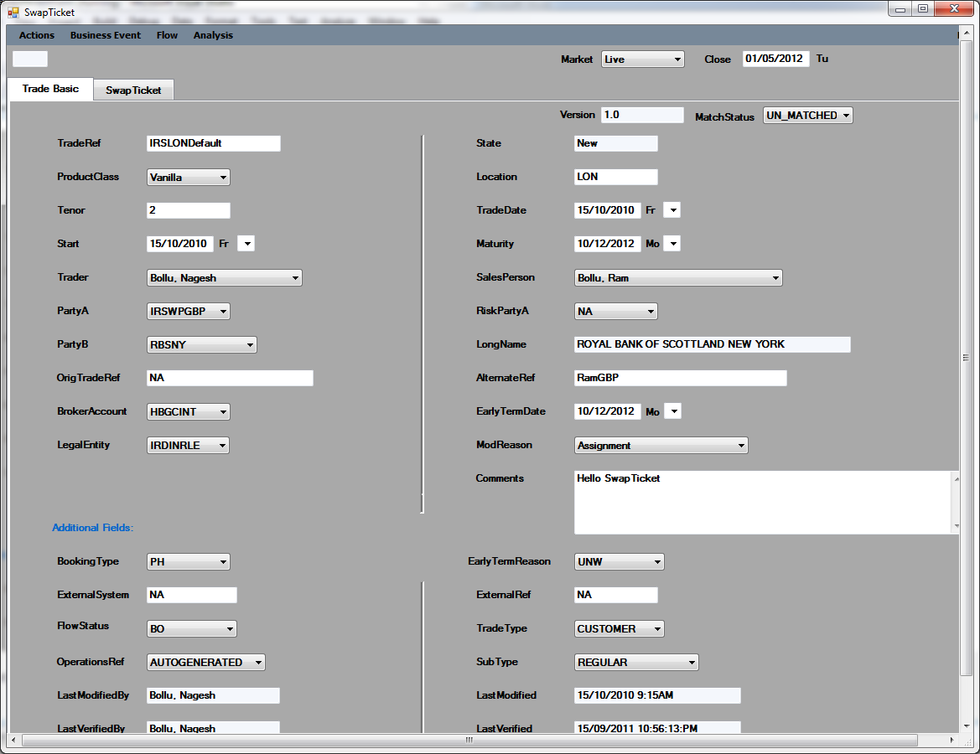
Swap Pricing Screen:-

Slide 14
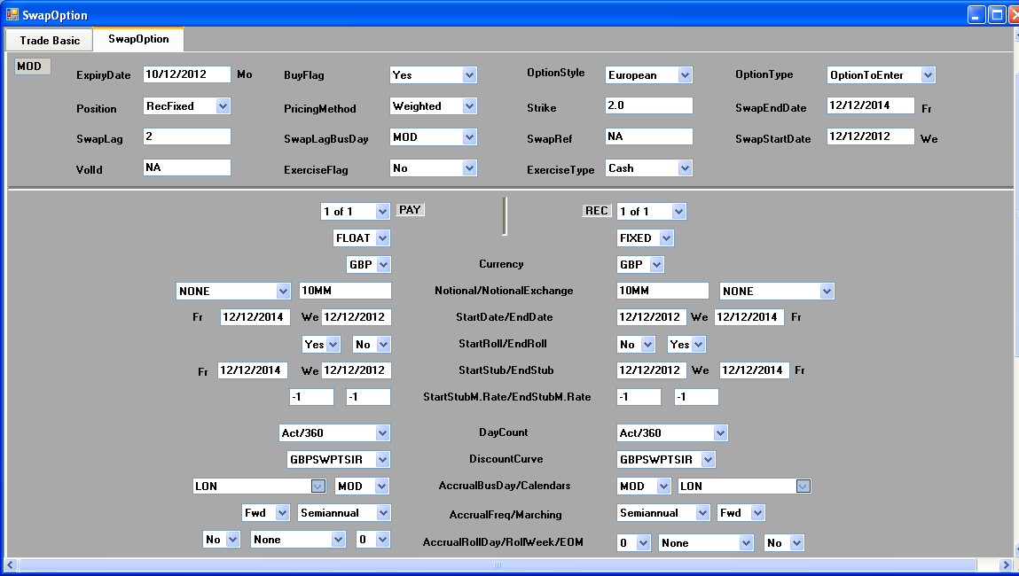
Swaption Pricing Screen:

Slide 15
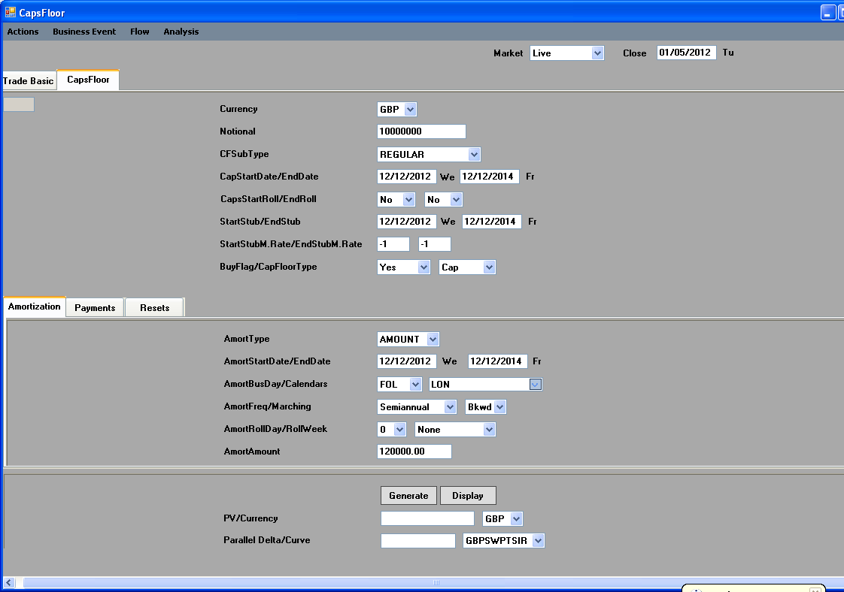
Caps/floor Pricing Screen:-

Slide 16
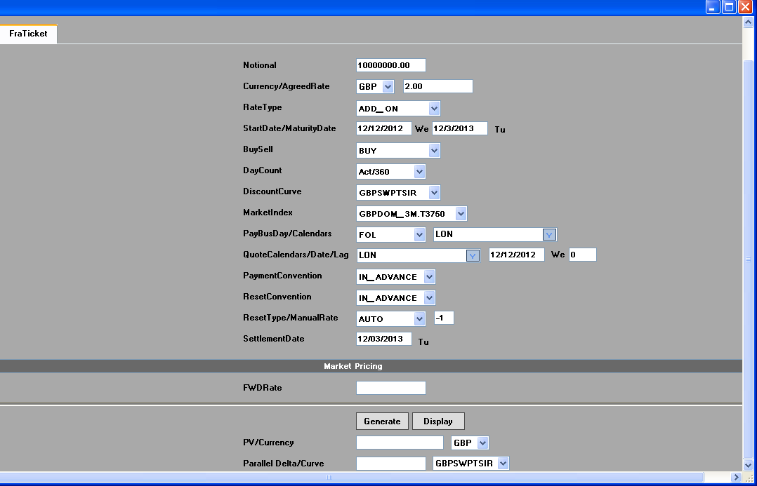
FRAs Pricing Screen:

Slide 17
Trade Reference: Displays the ID of the current deal, if the deal has already been saved If the deal has not been saved, the Deal field is blank. The Deal field can also be used to call up existing deals in the following ways- If you know the ID of the deal you want type it into the Deal field and press [Enter].The deal is loaded into the Pricing or deal entry window. Product Class:- Name of the Product like Vanilla Swap, and Xccy, Basis, Fx Reset, and OIS etc Tenor: Lets you specify the tenor of the swap as either a tenor code or as a year fraction, to determine the date for the Termination field. Once you enter a tenor period in the Tenor field, the system generates the termination date based on the tenor entered, taking into account the holiday schedules, frequency, marching and business day conventions (where applicable) specified in the Settlement section. If any of these settlement fields are changed after the tenor is entered, or you change the dates in the Effective and Termination fields, the tenor is calculated and displayed in the Tenor field in year fraction

Slide 18
Trade Date:- The trade date is the date on which the deal was booked in Derivatives Connect.If the deal is a new deal ,then the date will be today's date. Start Date:- Displays the date on which the deal begins. To change the date in this field you can either enter a new date, or use the plus (+) or minus (-) signs to add or subtract days (d), weeks (w), months (m) or years (y) to/from the date displayed. For example, to add five days to the displayed date, highlight the current date by double-clicking on it, type +5d and press [Enter]. The new date is displayed. You can also type t for today. Maturity:- Displays the termination date of the swap

Slide 19
Trader:- The trader field corresponds to the SOE Id of the trader. Upon opening the pricing screen, the users SOE Id defaults in the Trader field Salesperson:- Salesperson generates business within the company and is allowed to enter trades Party B: The counter party is the customer with whom the deal is being done and is often generically referred to as the Street. OrgTrade ref: Specifies the field If the trade is a rebooked trade that trade is original trade reference

Slide 20
Alternate Ref: Group id or diff name or alias to the same deal Broker: Each deal must have a broker specified. The Broker is an external middle man through which the two counter parties in a deal communicate. Since the broker is the intermediary through whom the deal is done, for the provision of this service, they earn a fee. Legal Entity: An individual or organization which is legally permitted to enter into a contract, and be sued if it fails to meet its contractual obligations Mod Reason: The purpose of this field is to allow the counterparty for the particular deal to be changed. the counterparty name can be changed directly in the IRD swap ticket

Slide 21
Comments: The comment field is a free format field and can be used to enter any detail which the originator and/or trader deem significant in terms of the deal Booking Type: This fields Specifies the phone, electronic or marketwire etc booking the traders External System: If originated in diff system - what is the system name External Ref: original system generated ref Flow Status: where in the flow - verification or BO or MO etc

Slide 22
Trader Type: Specifies to which type the trade belongs this categorization. Exercise depends on the trades structure and risk profile . there are two types 1. Standard trade 2. Non Standard trade Operation Ref: Specifies the back office id - auto generated with logic - customer understand this ref only Sub Type: sub product like XCCY, FX Reset REGULAR, XCCY,FXRESET,OIS,BASIS,OPTION TO ENTER, OPTION TO CANCEL etc LastModifiedBy:- A User who Creates and posts an un authorized record , template or other information. such as the closing market quotes and day Last Modified: A user who creates and Modified of the record information to the particular date and time to the visible on the trade

Slide 23
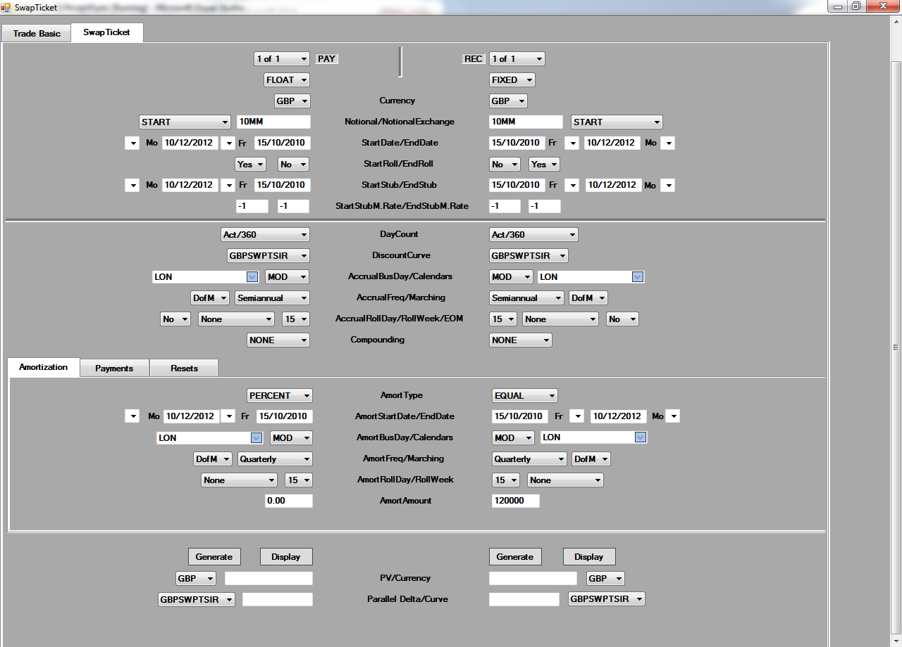
2.Swap Ticket Details:-

Slide 24
Swap Option:- A Swaption is an option granting its owner the right but not the obligation to enter into an underlying swap. Although options can be traded on a variety of swaps, the term "Swaption" typically refers to options on interest rate swaps. A Swaption gives its holder to right to enter into a swap. It is exercised if the strike rate of the swap is more favorable than the prevailing market swap rate, it expires worthless otherwise. If exercised, the holder then enters into an interest rate swap as determined in the Swaption contract. Components of Swaption:- Notional: The notional amount (or notional principal amount or notional value) on a financial instrument is the nominal or face amount that is used to calculate payments made on that instrument. This amount generally does not change hands and is thus referred to as notional.

Slide 25
Maturity of the option: - A type of option in which the put or call matures before the final expiration date. The variable maturity option matures earlier if the underlying instrument significantly changes in price before an early maturity date stated in the option contract. Strike rate:- The fixed price at which the owner of an option can purchase (in the case of a call), or sell (in the case of a put), the underlying security or commodity. It's the price at which the stock will be bought or sold when the option is exercised. The strike price is often called the exercise price. For example, an IBM May 50 Call has a strike/exercise price of $50 a share. When the option is exercised the owner of the option will buy (Call option) 100 shares of IBM stock for $50 a share. Expiry Date: The last date on which the option can be exercised However, in order to understand the concept of a Swaption and also the purpose of the fields in the CDS Swaption pricing screen, it is necessary to understand the basics of option.

Slide 26
Option:- In finance, an option is a contract between a buyer and a seller that gives the buyer of the option the right, but not the obligation, to buy or to sell a specified asset (underlying) on or before the option's expiration time, at an agreed price, the strike price. In return for granting the option, the seller collects a payment (the premium) from the buyer. Granting the option is also referred to as "selling" or "writing" the option. There are Two Types of Option:- 1.Put Option : A call option gives the buyer of the option the right but not the obligation to buy the underlying at the strike price. It is a financial contract between two parties, the buyer and the seller of this type of option. It is the option to buy shares of stock at a specified time in the future. Often it is simply labeled a "call". The buyer of the option has the right, but not the obligation to buy an agreed quantity of a particular commodity or financial instrument (the underlying instrument) from the seller of the option at a certain time (the expiration date) for a certain price (the strike price). The seller (or "writer") is obligated to sell the commodity or financial instrument

Slide 27
Call Option:- A put option gives the buyer of the option the right but not the obligation to sell the underlying at the strike price. A put option (usually just called a "put") is a financial contract between two parties, the writer (seller) and the buyer of the option. The buyer acquires a short position by purchasing the right to sell the underlying instrument to the seller of the option for specified price (the strike price) during a specified period of time. If the option buyer exercises their right, the seller is obligated to buy the underlying instrument from them at the agreed upon strike price, regardless of the current market price. In exchange for having this option, the buyer pays the seller or option writer a fee (the option premium). Option Style:- Naming conventions are used to help identify properties common to many different types of options. These include: European option - an option that may only be exercised on expiration. American option - an option that may be exercised on any trading day on or before expiration. Bermudan option - an option that may be exercised only on specified dates on or before expiration.

Slide 28
Caps/Floor: Caps:- An interest rate cap is actually a series of European interest call options (called caplets), with a particular interest rate, each of which expire on the date the floating loan rate will be reset. At each interest payment date the holder decides whether to exercise or let that particular option expire. In an interest rate cap, the seller agrees to compensate the buyer for the amount by which an underlying short-term rate exceeds a specified rate on a series of dates during the life of the contract. Interest rate caps are used often by borrowers in order to hedge against floating rate risk. Benefits of the Caps:- 1.The cap gives full protection against rising interest rates beyond the cap level. 2.cap gives you freedom to benefit from future falls in interest rates. 3.If you pay off the loan, you can sell us back the Interest-Rate Cap and may receive some value. 4.If the counterparty is paying floating on a notional, then they will purchase a cap.

Slide 29
Features of Caps:- 1.You can get an Interest-Rate Cap from a bank other than the one who gave you the original loan. 2.The Interest-Rate Cap does not need to be based on a particular loan. 3.You can use the cap for any loans you already have or expect to have. 4.We provide Interest-Rate Caps in US Dollars and the other major currencies. 5. We can arrange Interest-Rate Caps on Libor and also the BMA index 6.We can arrange Interest-Rate Caps for different maturities.

Slide 30
Floor: Floors are similar to caps in that they consist of a series of European interest put options (called caplets) with a particular interest rate, each of which expire on the date the floating loan rate will be reset. In an interest rate floor, the seller agrees to compensate the buyer for a rate falling below the specified rate during the contract period. A collar is a combination of a long (short) cap and short (long) floor, struck at different rates. The difference occurs in that on each date the writer pays the holder if the reference rate drops below the floor. Lenders often use this method to hedge against falling interest rates. Benefits of Floor: The floor will give you a guaranteed minimum return on your cash. The floor will give you the freedom to take advantage of higher interest rates. If your cash balance is run down, you can sell us back the floor and you may receive some value depending on prevailing rates and the length of the remaining term.

Slide 31
Features Of Floor: 1.You can arrange an Interest-Rate Floor with any bank. It doesn't have to be the one where your cash is deposited. 2.You can use the floor for deposits you already have or expect to receive. 3.We can arrange Interest-Rate Floors for different maturities. 4.We usually pay compensation at the end of each relevant Libor period when interest rates fall below the floor. 5.You pay the premium for the Interest-Rate Floor up front The premium you pay will depend on: The guaranteed rate and the swap rate; How long you want the floor for; and How often interest rates are

Slide 32
FRAs: An FRA is an agreement to borrow or lend a notional cash sum for a period of time lasting up to twelve months, starting at any point over the next twelve months, at an agreed rate of interest (the FRA rate). The “buyer” of an FRA is borrowing a notional sum of money while the “seller” is lending this cash sum. Note how this differs from all other money market instruments. In the cash market, the party buying a CD or bill, or bidding for stock in the repo market, is the lender of funds. In the FRA market, to “buy” is to “borrow”. Of course, we use the term “notional” because with an FRA no borrowing or lending of cash actually takes place, as it is an off-balance sheet product. The notional sum is simply the amount on which interest payment is calculated.

Slide 33
Notional : The amount for which the FRA is traded. Trade date: The date on which the FRA is dealt. Settlement date: The date on which the notional loan or deposit of funds becomes effective, that is, is said to begin. This date is used, in conjunction with the notional sum, for calculation purposes only as no actual loan or deposit takes place. Maturity date: The date on which the notional loan or deposit expires. FRA rate: The interest rate at which the FRA is traded. Settlement sum: The amount calculated as the difference between the FRA rate and the reference rate as a percentage of the notional sum, paid by one party to the other on the settlement date.

Slide 34
Exchange Trade Products:- An exchange-traded fund (or ETF) (also known as Exchange-Traded Product (ETP)) is an investment fund traded on stock exchanges, much like stocks. An ETF holds assets such as stocks or bonds and trades at approximately the same price as the net asset value of its underlying assets over the course of the trading day. Money Market Future Option:- In many cases, options are traded on futures, sometimes called simply "futures options". A put is the option to sell a futures contract, and a call is the option to buy a futures contract. For both, the option strike price is the specified futures price at which the future is traded if the option is exercised. The principal advantage of futures options over options on physicals stems from the fact that most traders find delivery requirements less burdensome for futures options than options on actual physical items. Futures markets tend to be more liquid and have lower transactions costs than underlying cash markets. Thus, while the exercise of an option on an actual cash item requires the writer to buy or deliver that item, the exercise of a futures option results only in a long or short futures position, which is easy to offset.

Slide 35
Bond Futures:- A bond future is a contractual obligation for the contract holder to purchase or sell a bond on a specified date at a predetermined price. A bond future can be bought in a futures exchange market and the prices and dates are determined at the time the future is purchased. Bond contracts are standardized, and are overseen by a regulatory agency that ensures a certain level of equality and consistency. However, this form of derivative can be risky because it involves trading at a future date with only current information. The risk is potentially unlimited, for either the buyer or seller of the bond because the price of the underlying bond may change drastically between the exercise date and the initial agreement. Being exchange traded, the future contracts regulate all participants enforcing settlement and margin payments. Most of the contracts are not settled at expiry and either they get rolled over or they get closed out - hence it is not important to take positions in the underlying. Therefore the parties are able to short sell as well as take long positions bigger than what they could take in the physical market. Futures have different underlying tenors such as five yr, 10 yr and so on. Also, futures of next few expiry dates are traded simultaneously.

Slide 36
Bond Future Option:- An option traded on a regulated exchange where the terms of each option are standardized by the exchange. The contract is standardized so that underlying asset, quantity, expiration date and strike price are known in advance. Over-the-counter options are not traded on exchanges and allow for the customization of the terms of the option contract. All terms are standardized except price. The exchange establishes expiration date and expiration prices as well as minimum price quotation unit. The exchange also establishes whether the option is American or European, its contract size and whether settlement is in cash or in the underlying security. Usually trade in lots in which 100 shares of stock = 1 option The most active options are the ones that trade at the money, while deep-in-the-money and deep-out-of-the money options don't trade very often.

Slide 37
Bond Options:- An option contract in which the underlying asset is a bond. Other than the different characteristics of the underlying assets, there is no significant difference between stock and bond options. Just as with other options, a bond option allows investors to hedge the risk of their bond portfolios or speculate on the direction of bond prices with limited risk. A buyer of a bond call option is expecting a decline in interest Rates and an increase in bond prices. The buyer of a put bond option is expecting an increase in interest rates and a decrease in bond prices. Like other options, an option on a futures contract is the right but not the obligation, to buy or sell a particular futures contract at a specific price on or before a certain expiration date. These grant the right to enter into a futures contract at a fixed price. A call option gives the holder (buyer) the right to buy (go long) a futures contract at a specific price on or before an expiration date. The holder of a put option has the right to sell (go short) a futures contract at a specific price on or before the expiration date.

Slide 38
Conclusion: ETFs have a lot to offer. They're flexible and low-cost, and their underlying portfolios are protected from the impact of investor trading, making them more tax-efficient than most mutual funds. There are also ETFs that address specific sub sectors that regular mutual funds do not. Advantages:- Trading Flexibility One key advantage that ETFs have over traditional mutual funds is trading flexibility. ETFs trade throughout the day, so you can buy and sell them when you want. Costs In terms of the annual expenses charged to investors, ETFs are considerably less expensive than the vast majority of mutual funds. Performance Because they are shielded from investor trading, ETFs shouldn't suffer from having to keep cash on hand to meet redemptions, or from being forced to sell stocks into a declining market for the same purpose.

Slide 39
!!THANK YOU!!

